Slide 1
Tour and Travelling Management System
Aditi Rajbongshi
ID : CSE 063 07 385
Nazmus Sakib
ID : CSE 057 06 986
Farzana Akhter
ID : CSE 063 07 425

Slide 2
Introduction
What is Tour Management System?
01
What is the purpose of Tour Management system?
02
Who can use the system?
03

Slide 3




Motivations for this Project
Integrated Software
Helps the Tourism
Standalone Platform
Modules

Slide 4



Features
Directly Connected
Modify and Delete Data
Packages

Slide 5

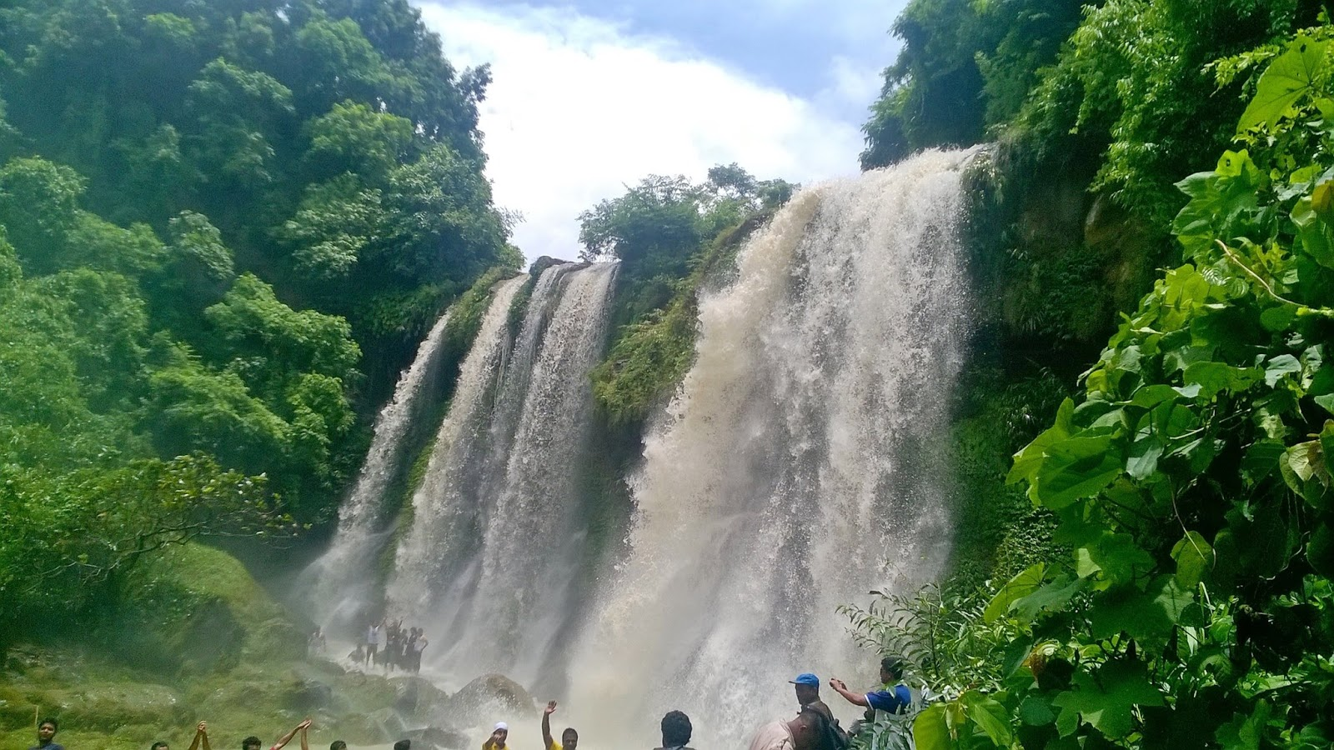



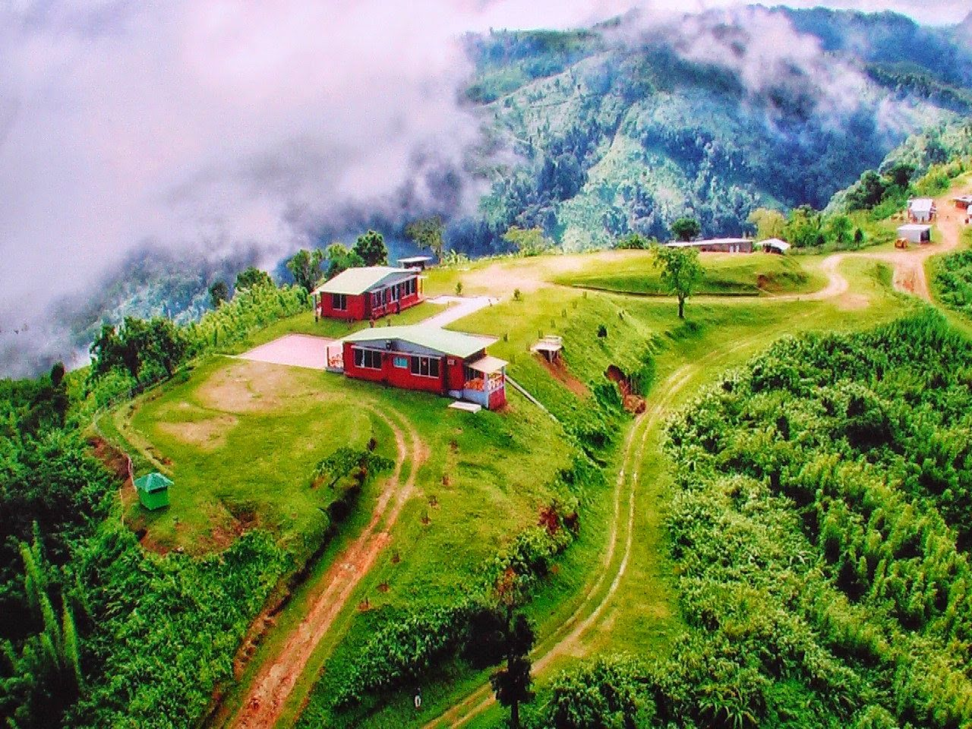
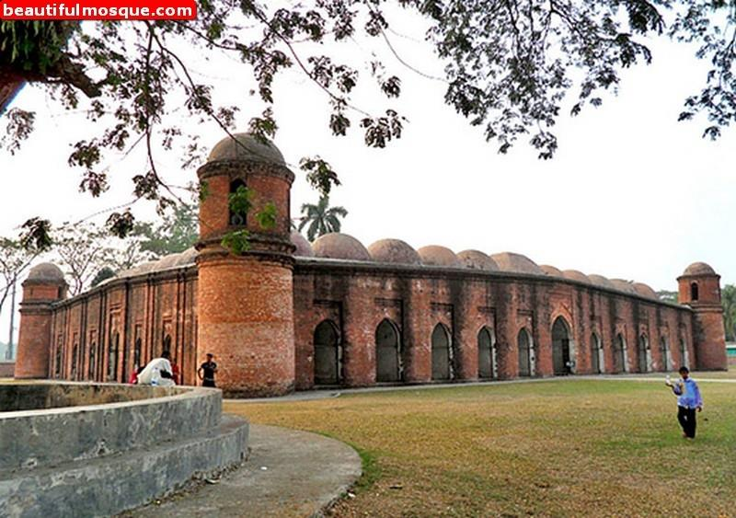
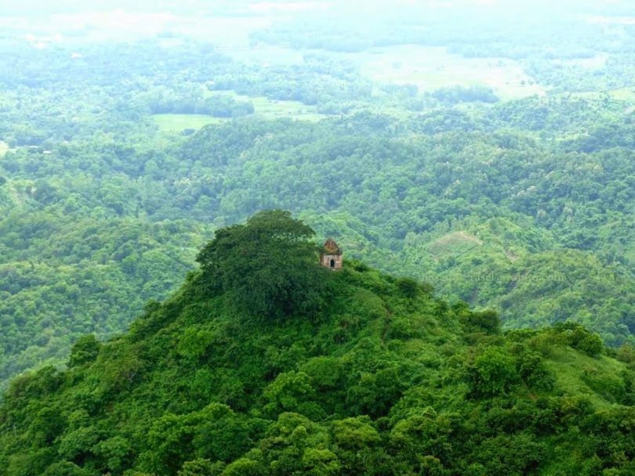
Features
Social Media Link
Displaying Places
Feedback

Slide 6
Feasibilities
Technical Feasibilities
Operational Feasibilities
Economical Feasibilities

Slide 7
Hardware
Laptop & PC
Internet Connection
Technical
Software
Any type web browser
- Google Chrome, Internet Explorer etc.
Operational
Economical
Technology
Up to Date
Secured

Slide 8
User Level
All kinds of people
Technical
User Interface
Operational
Ease to understand
Need to basic knowledge of web browser.
Efficient
Economical
Error Handling and Feedback

Slide 9

Low Budget
Technical Cost
Software Cost
Other Cost
Technical
Operational
Economical

Slide 10




Project Scheduling
Analysis
Design
Development
Testing

Slide 11
Analysis
1 | On-site Meeting | None | 1w
2 | Discussion with Stakeholder | 1 | 1w
3 | Analysis Requirement | 1,2 | 1w

Slide 12
Design
4 | System Design | 3 | 3w
5 | Database Design | 3,4 | 1w
6 | Interface Design | 1,4 | 2w

Slide 13
Development
7 | Develop System Modules | 4 | 1w
8 | Integrate System Modules | 7 | 1w
9 | Perform Initial Testing | 8 | 1w

Slide 14
Testing
10 | Perform System Testing | 9 | 1w
11 | Feedback & Releasing | 10 | 1w

Slide 15
Gantt Chart
ID | Task Name | Start |  | Finish | Duration
 |  |  |  |  |  |  | 08/09 | 15/09 | 22/09 | 29/09 | 06/10 | 13/10 | 20/10 | 27/10 | 04/11 | 11/11 | 18/11
1 | On-site Meeting | 07/09/19 |  | 13/09/19 | 1w
2 | Discussion with Stakeholder | 14/09/19 |  | 20/09/19 | 1w
3 | Analysis Requirement | 21/09/19 |  | 27/09/19 | 1w
4 | System Design | 28/09/19 |  | 18/10/19 | 3w
5 | Database Design | 19/10/19 |  | 25/10/19 | 1w
6 | Interface Design | 19/10/19 |  | 02/11/19 | 2w
7 | Develop System Modules | 19/10/19 |  | 25/10/19 | 1w
8 | Integrate System Modules | 26/10/19 |  | 02/11/19 | 1w
9 | Perform Initial Testing | 03/11/19 |  | 09/11/19 | 1w
10 | Perform System Testing | 10/11/19 |  | 16/11/19 | 1w
11 | Feedback & Releasing |  | 17/11/19 | 23/11/19 | 1w

Slide 16
Risk Analysis
Avoiding travel and security risk.
Handling emergencies and contacting parents.
All participants register for travel insurance.
Database backup.

